Slide 1




Excel
Training
for Beginners
SAID FAWZY
Manager of Information Center
Tendering Department
Arab Contractors

Slide 2


Excel
Training
for Beginners
SAID FAWZY
10
Sharing Workbooks

Slide 3






90%
90%
Protecting Workbooks and Worksheets
Spell Checking
Inspecting the Workbook
Saving the Workbook in Different Formats
Exam 10: Sharing Workbooks

Slide 4
Excel
Training
for Beginners
SAID FAWZY
Protecting Workbooks and Worksheets
1

Slide 5
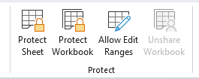
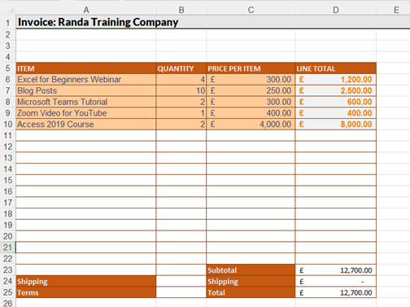
Protecting Workbooks and Worksheets
Protect Sheet

Slide 6
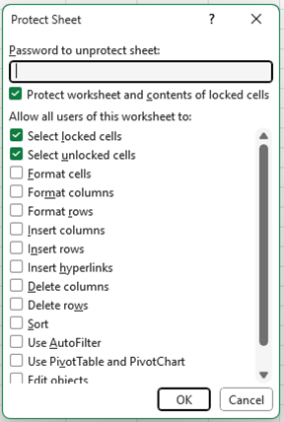
Protecting Workbooks and Worksheets
Protect Sheet

Slide 7

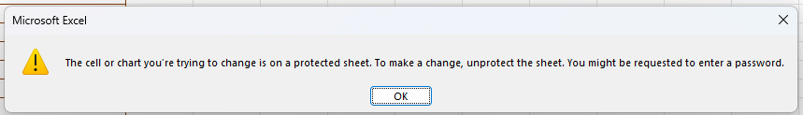
Protecting Workbooks and Worksheets
Protect Sheet

Slide 8
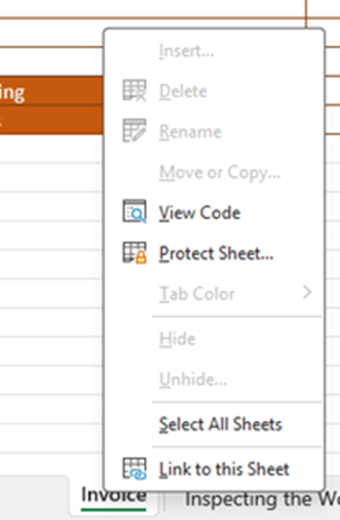
Protecting Workbooks and Worksheets
Protect Workbook

Slide 9
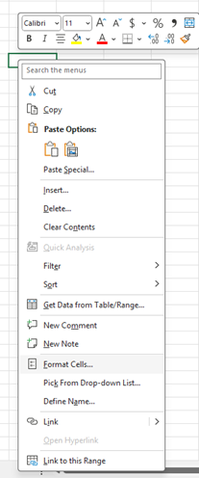
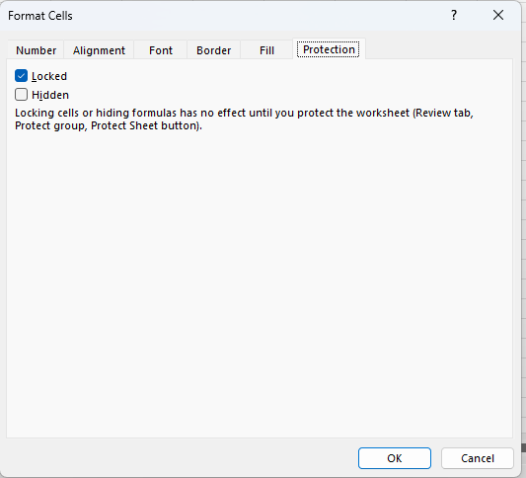
Protecting Workbooks and Worksheets
Protect Individual Cells

Slide 10
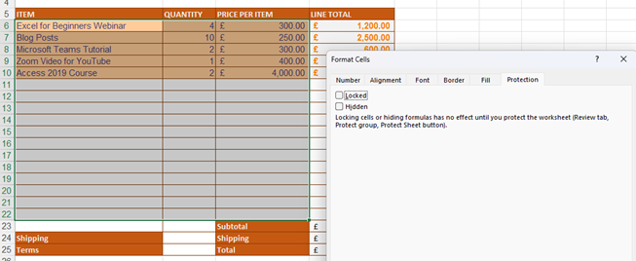
Protecting Workbooks and Worksheets
Protect Individual Cells

Slide 11
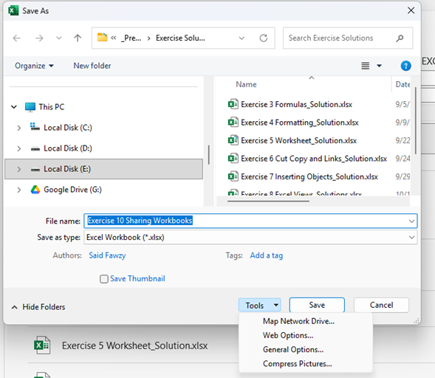
Protecting Workbooks and Worksheets
Protect workbook with a Password

Slide 12
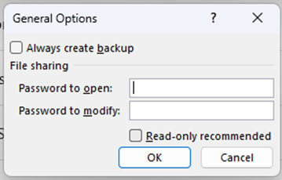
Protecting Workbooks and Worksheets
Protect workbook with a Password

Slide 13
Excel
Training
for Beginners
SAID FAWZY
2
Spell Checking

Slide 14
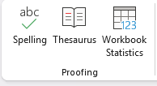
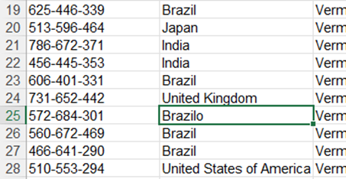

Spell Checking
Spelling

Slide 15
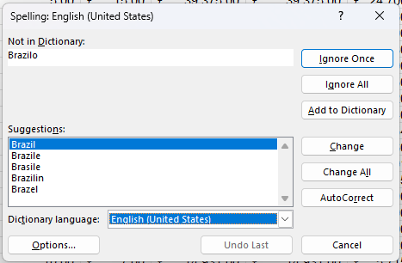
Spell Checking
Spelling

Slide 16
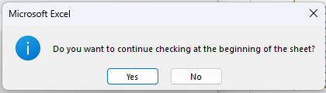
Spell Checking
Spelling

Slide 17
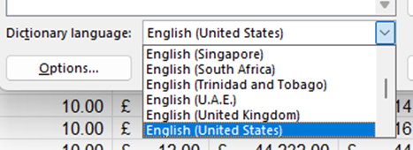

Spell Checking
Dictionary Language

Slide 18
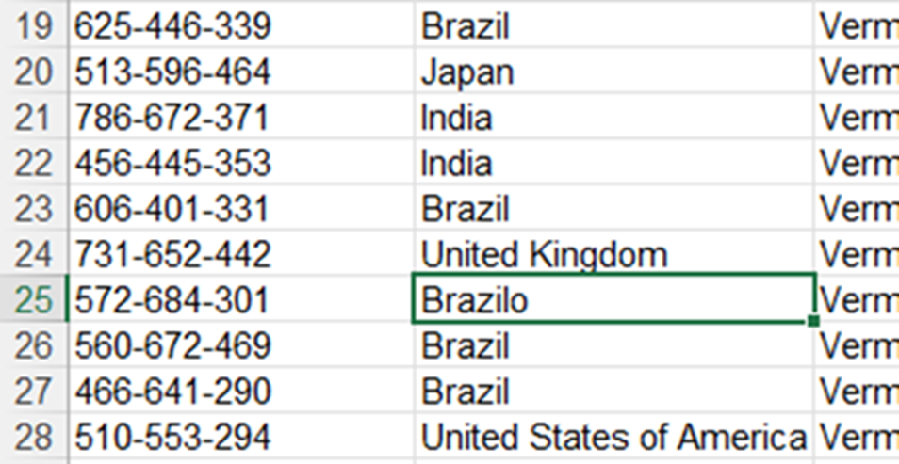
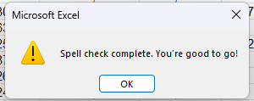
Spell Checking
Dictionary Language

Slide 19
Excel
Training
for Beginners
SAID FAWZY
3
Inspecting the Workbook

Slide 20
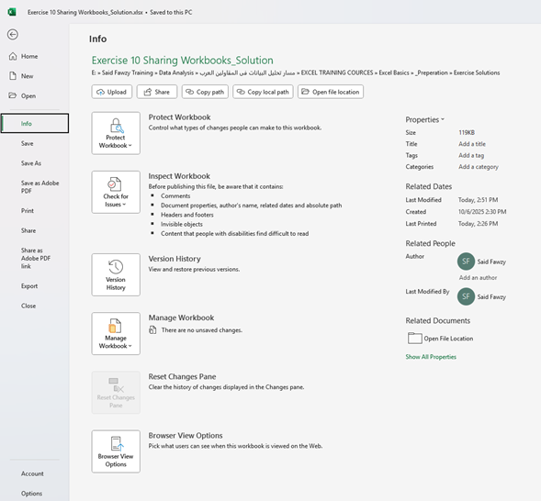
Inspecting the Workbook
Workbook Info

Slide 21
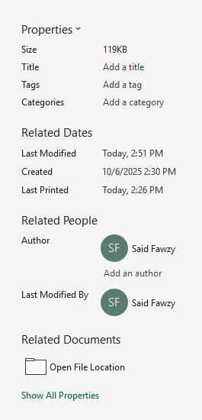
Inspecting the Workbook
Workbook Info

Slide 22
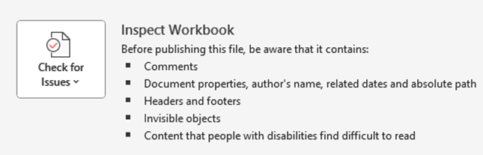
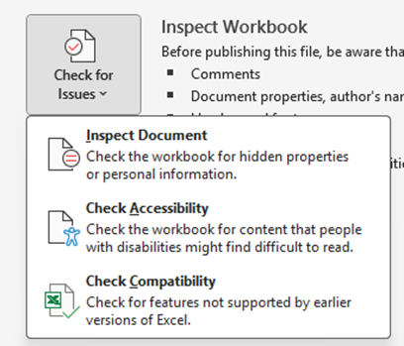
Inspecting the Workbook
Inspect Workbook Section

Slide 23
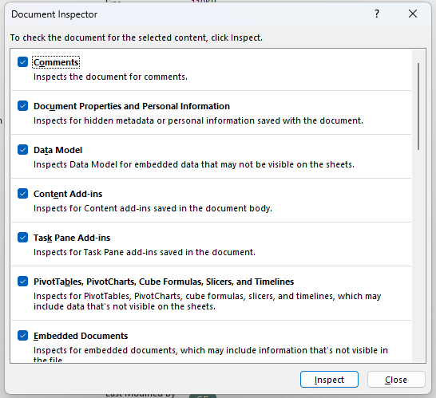
Inspecting the Workbook
Inspect Document

Slide 24
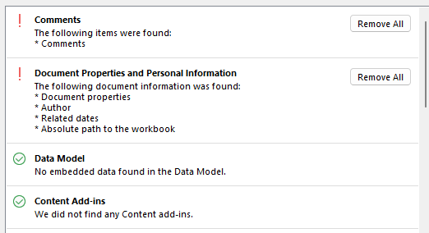
Inspecting the Workbook
Inspect Document

Slide 25
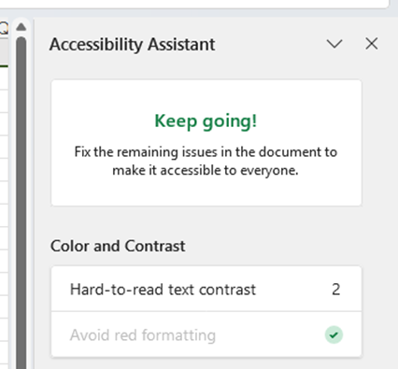
Inspecting the Workbook
Inspect Document

Slide 26
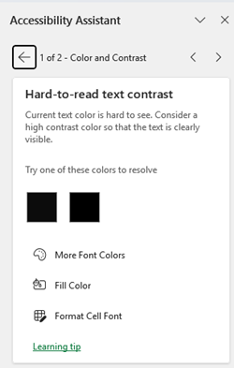
Inspecting the Workbook
Inspect Document

Slide 27
Inspecting the Workbook
Inspect Document

Slide 28
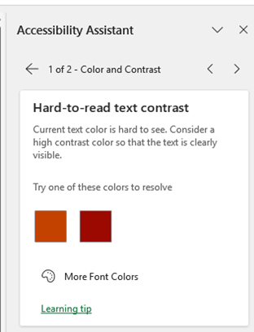
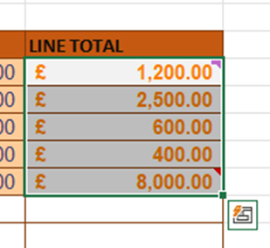
Inspecting the Workbook
Inspect Document

Slide 29
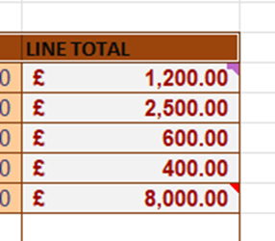
Inspecting the Workbook
Inspect Document

Slide 30
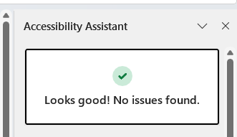
Inspecting the Workbook
Inspect Document

Slide 31
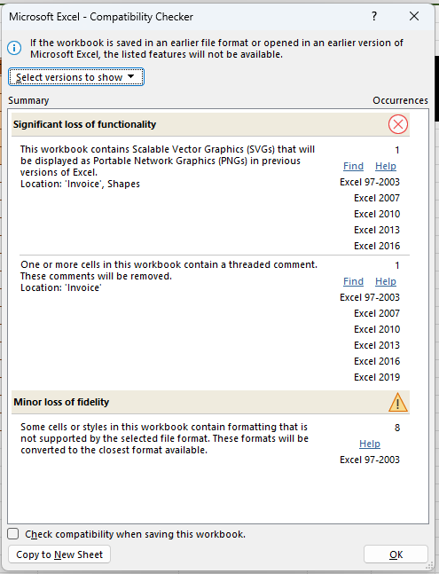
Inspecting the Workbook
Check Compatibility

Slide 32
Excel
Training
for Beginners
SAID FAWZY
4
Saving the Workbook in Different Formats

Slide 33
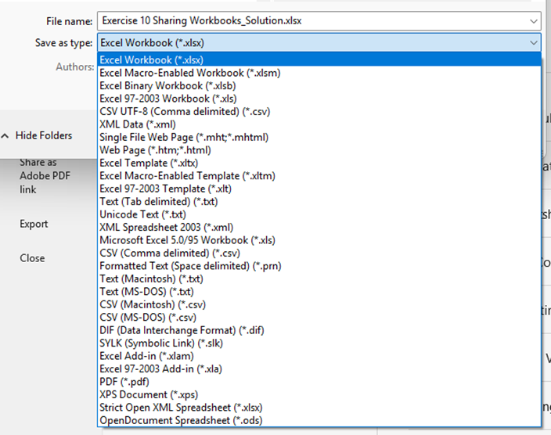
Saving the Workbook in Different Formats
Save As

Slide 34
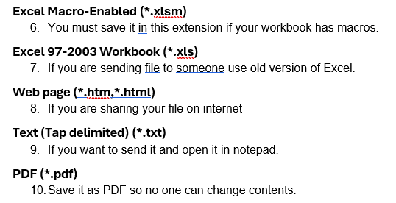
Saving the Workbook in Different Formats
Save As

Slide 35
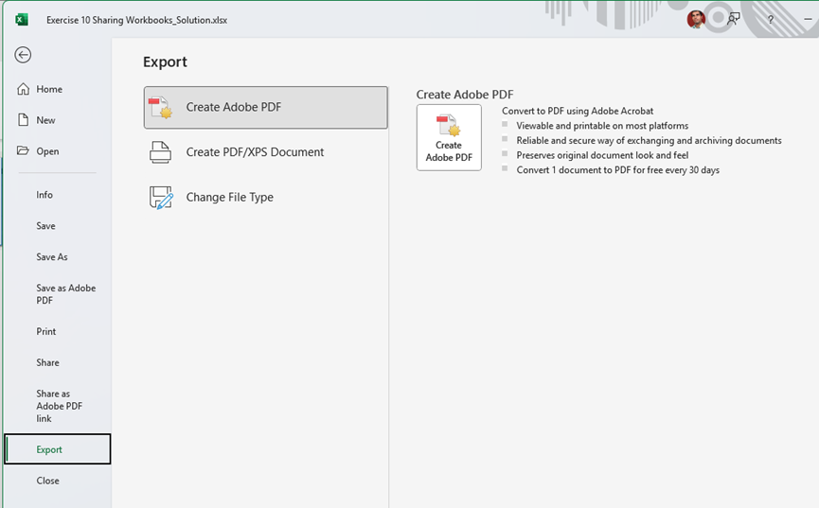
Saving the Workbook in Different Formats
Export

Slide 36
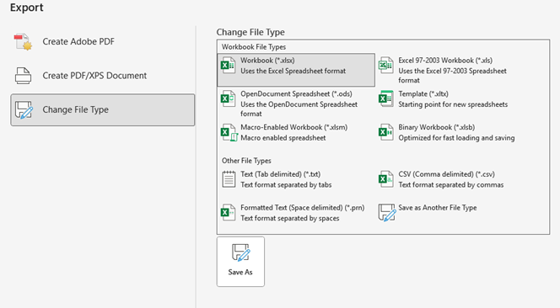
Saving the Workbook in Different Formats
Export

Slide 37
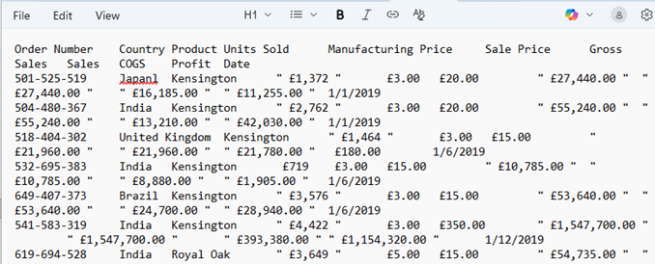
Saving the Workbook in Different Formats
Export

Slide 38
Excel
Training
for Beginners
SAID FAWZY
Exam 10
Sharing Workbooks

Slide 39
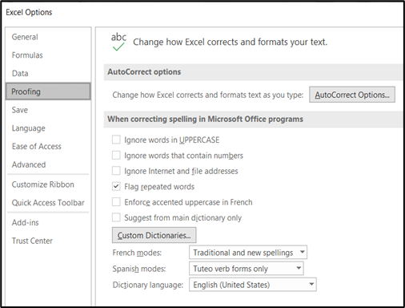
Exam 10: Sharing Workbooks
Spell Checking
On the 'P&L' worksheet, run a spell check and correct any errors.
Ensure that the spell check has picked up ALL errors.
Review 'Proofing Settings' if the spell check isn't picking up all incorrect words.

Slide 40
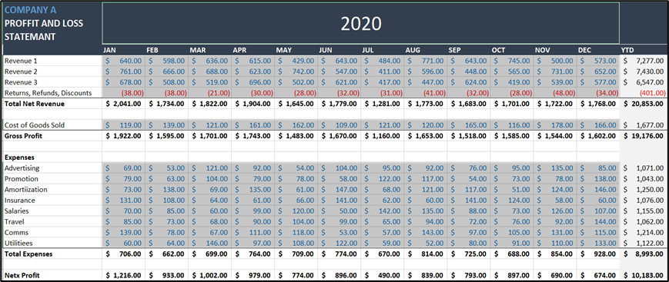
Exam 10: Sharing Workbooks
Protecting Cells and Worksheets
Apply protection to the worksheet so that only the cells that DO NOT contain formulas can be edited.
Unlock all cells that contain 'Constants (Numbers)'.
(HINT: To make this easier, consider using 'GoTo Special' to select all constants.)
Protect the worksheet with a password.
Test the protection is working by editing a cell that contains a formula.

Slide 41



